Slide 1
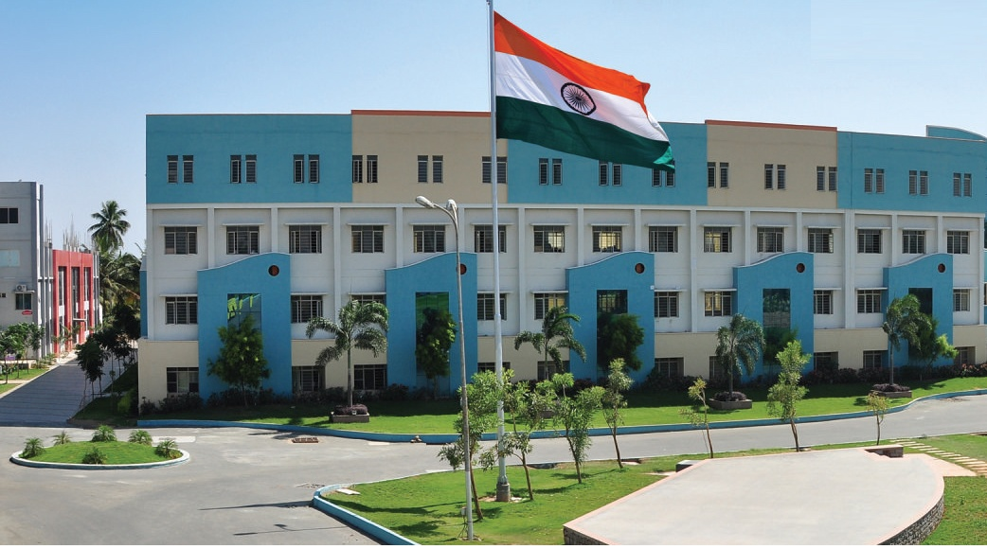
SRI ESHWAR COLLEGE OF ENGINEERING academic year: 2017-18 department: CIVIL ENGINEERING section: Iv - CIVIL
DESIGN PROJECT REVIEW – 1
Date of review: 02-09-2017

Slide 2
PLANNING, ANALYSIS & DESIGN OF FIVE STAR HOTEL
Batch Members
1 SANTHOSH M K S
2 KEERTHIVASAN P
3 KEERTHIVASAN R
4 JAYAKUMAR P
Guide Name:
Mr. Pradeep Kumar.D
Asst. Prof/Civil Dept.

Slide 3
Presentation Outline
Abstract
Literature Survey’s
Plan
Work Schedule

Slide 4
Abstract of the project
The tourist and business sector developing in the Coimbatore city, we have planned to design the construction of the building of a five star hotel with world class amenities.
A grand revival of Coimbatore hospitality.
Purple Ace, a luxury hotel combines with pleasure, style, elegance & form with function.

Slide 5
Methodology
Selection of Title
Literature Study
Site Visit
Plan
Analysis
Design

Slide 6
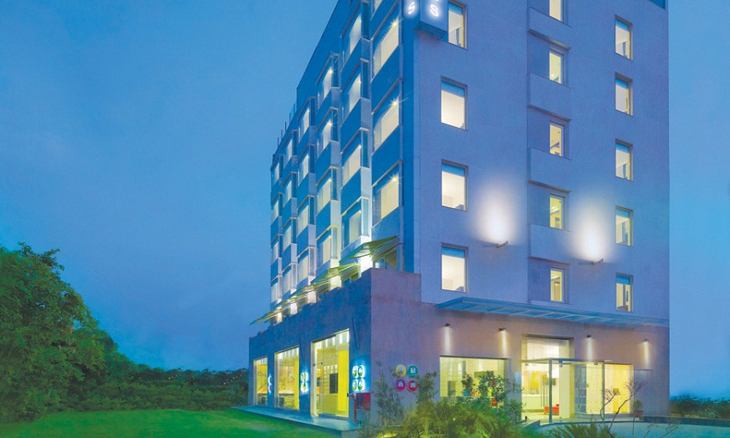
Out-Rigger System

Slide 7
Literature Survey (Cont’d..)
JOURNAL | SSRG International Journal of Civil Engineering (SSRG-IJCE) – volume 2 Issue 3 March 2015
TITLE | A Review on Foundation of Buildings & Structures
AUTHOR(S) | Sumit Bhardwaj, Qazi Naveed Mehraj
INFERENCE | The purpose of each structural part as an integral part for the stability & sustainability of the building & emphasizes the selection of various materials & methodology used, including the storage, earthwork as well as the drawing & planning required.

Slide 8
Literature Survey (Cont’d..)
JOURNAL | International Journal of High rise Buildings, September 2012 Volume 1 Number 3
TITLE | Outrigger System Design Considerations
AUTHOR(S) | Hi Sun Choi, Leonard Joseph
INFERENCE | In Buildings more than G+5 storey Outriggers are cost efficient and load transmission is easy from spine to column.

Slide 9
Literature Survey (Cont’d..)
JOURNAL | International Journal of Research in Engineering and Technology eISSN: 2319-1163 | pISSN: 2321-7308
TITLE | DESIGN OF MULTI STOREY HOTEL BUILDING RESTING ON SINGLE COLUMN
AUTHOR(S) | Madireddy Satyanarayana
INFERENCE | Limit state method of design is adopted. The Design Aids of Concrete and detailing is understood.

Slide 10
Literature Survey (Cont’d..)
JOURNAL | CTBUH JOURNAL, 2015 ISSUE 2
TITLE | Advanced structural Technology for High Rise Hotel Building in Japan
AUTHOR(S) | Masayoshi Nakai,
INFERENCE | Building structures primarily need to support gravity weight and seismic members should absorb earthquake energy.

Slide 11
Literature Survey (Cont’d..)
JOURNAL | IJREAT International Journal of Research in Engineering & Advanced Technology, Volume 1, Issue 2, April-May, 2013 ISSN: 2320 - 8791
TITLE | Study of the Analysis and Design of Girder’s
AUTHOR(S) | Amit Saxena, Dr. Savita Maru
INFERENCE | Shear force and Cost of a T- Shaped beam Girder is more efficient. Moreover they didn’t need more sophisticated formwork as well as it is economically sounded

Slide 12
Literature Survey (Cont’d..)
JOURNAL | International Journal for Scientific Research & Development| Vol. 3, Issue 09, 2015 ISSN : 2321-0613
TITLE | Study of Seismic Analysis between Conventional RC Frame and Flat Slab
AUTHOR(S) | Muniraju K.S, Subramanya K.G
INFERENCE | The behavior of flat slab frame with different heights is inferred. The Conventional R.C frame and flat slab R.C. frame with different height for different combinations of static loading is learnt.

Slide 13
Literature Survey (Cont’d..)
JOURNAL | International journal of latest trends in Engineeering and Technology; IISN:2278-621X
TITLE | Analysis & Design of Flat Slab
AUTHOR(S) | Gaurav ravindra Chavan, Dr.S.N.Tande
INFERENCE | A floor system plays an important role in the overall cost and service of a building. Flat Slabs are mostly used because of its advantages.

Slide 14
Literature Survey (Cont’d..)
JOURNAL | Indian Concrete Journal, July 1982, India.
TITLE | “Trapezonpan Roofing/Flooring Scheme”,
AUTHOR(S) | Gupta B.S., Jain S.K., Hira B.N.
INFERENCE | IPS(Indian Patent Stone) produces good wearing Properties. Red oxide flooring is an essential one for low cost flooring with amateur look.

Slide 15
Literature Survey (Cont’d..)
JOURNAL | International Conference on Civil Engineering Research (ICCER), Jan 27 2016
TITLE | Model Swimming Pool Design
AUTHOR(S) | Edwin Lomax
INFERENCE | The Hydraulic Flow of Water within the Swimming Pool Area Should be Precise And the Temperature and water level are to be checked regularly.

Slide 16
Literature Survey (Cont’d..)
JOURNAL | International Journal of Engineering Development and Research, 2016 Volume 4, Issue 2 | ISSN: 2321-9939
TITLE | A study of analysis and design of parking
AUTHOR(S) | Upendra singh dandotia, Rakesh Gupta, Mukesh Pandey
INFERENCE | Conventional Parking System is to be employed and the layout will be either at 30,45,60 degree Sideways.

Slide 17
Work Schedule
S.NO | DATE | WORK TO BE DONE | REMARKS
1 | 07-07-2017 | Selection of Title
2 | 17-07-2017 | Collection of Literature and Study
3 | 01-08-2017 | Planning by using AutoCAD
4 | 09-08-2017 | Structural Analysis by using E-Tabs
5 | 16-08-2017 | Design by Manual & Software
6 | 01-09-2017 | Checking the Reinforcements with reference to IS Code Book.
7 | 15-09-2017 | Preparation of book
8 | 28-09-2017 | Submission of Project

Slide 18
Queries?

